Slide 1


Slide 2

The Guys Who Brings It To You
…………………………………………………
Jalpa Vaghela
Komal Prajapati
Sanni Heruwala
Krunal Gohel
Bhumika Maisuriya
Prashant Tank

Slide 3

The Bubble Sort
…………………………………………………
Popular algorithm used for sorting data
“ Iverson” was the first to use name
‘bubble sort’ in 1962, even though used earlier
Unfortunately it is commonly used where the
number of elements is too large
Bubble sort algorithm gets name bubble because of sorting the elements in array in shorter range i.e just next value of the element in array is checked and swapped or we can say sorting function is perform in very smaller time that is why it is also called comparison sort.

Slide 4
Algorithm For Bubble Sort
……………………………………………………………………
Step 1: Repeat Steps 2 and 3 for i=1 to 10
Step 2: Set j=1
Step 3: Repeat while j<=n
(A) if a[i] < a[j]
Then interchange a[i] and a[j]
[End of if]
(B) Set j = j+1
[End of Inner Loop]
[End of Step 1 Outer Loop]
Step 4: Exit

Slide 5
C Program for Bubble Short
……………………………………………
#include<stdio.h>
#include<conio.h>
void main()
{
int i,n,temp,j,arr[25];
clrscr();
printf("Enter the number of elements in the Array: ");
scanf("%d",&n);
printf("\nEnter the elements:\n\n");
for(i=0 ; i<n ; i++)
{
printf(" Array[%d] = ",i);
scanf("%d",&arr[i]);
}
for(i=0 ; i<n ; i++)
{
for(j=0 ; j<n-i-1 ; j++)
{
if(arr[j]>arr[j+1]) //Swapping Condition is Checked
{
temp=arr[j];
arr[j]=arr[j+1];
arr[j+1]=temp;
}
}
}
printf("\nThe Sorted Array is:\n\n");
for(i=0 ; i<n ; i++)
{
printf(" %4d",arr[i]);
}
getch();
}

Slide 6
The Bubble Sort
……………………………………………….
Starts at one end of the array and make repeated scans through the list comparing successive pairs of elements
5 3 6 2 8 9 1
If the first element is larger than the second, called an inversion, then the values are swapped
3 5 6 2 8 9 1

Slide 7
The Bubble Sort
…………………………………………………..
Each scan will push the maximum element to the top
3 5 6 2 8 9 1
3 5 6 2 8 9 1
3 5 2 6 8 9 1
3 5 2 6 8 9 1
3 5 2 6 8 9 1
3 5 2 6 8 1 9

Slide 8
2 3 5 6 1 8 9
2 3 5 1 6 8 9
2 3 5 1 6 8 9
2 3 5 1 6 8 9
2 3 1 5 6 8 9
2 3 1 5 6 8 9
2 1 3 5 6 8 9
1 2 3 5 6 8 9
The Bubble Sort
………………………………………………….
This is the “bubbling” effect that gives the bubble sort its name
This process is continued until the list is sorted
The more inversions in the list, the longer it takes to sort
3 5 2 6 8 1 9
3 5 2 6 8 1 9
3 2 5 6 8 1 9
3 2 5 6 8 1 9
3 2 5 6 8 1 9
3 2 5 6 1 8 9
2 3 5 6 1 8 9
2 3 5 6 1 8 9

Slide 9
Bubble Sort Time Complexity
............................................................................................
Best-Case Time Complexity
The scenario under which the algorithm will do the least amount of work (finish the fastest)
Worst-Case Time Complexity
The scenario under which the algorithm will do the largest amount of work (finish the slowest)

Slide 10
Bubble Sort Time Complexity
…………………………………………………
Best-Case Time Complexity
Array is already sorted
Need 1 iteration with (N-1) comparisons
Worst-Case Time Complexity
Need N-1 iterations
(N-1) + (N-2) + (N-3) + …. + (1) = (N-1)* N / 2
Called Linear Time
O(N)
Order-of-N
Called Quadratic Time
O(N²)
Order-of-N-square

Slide 11
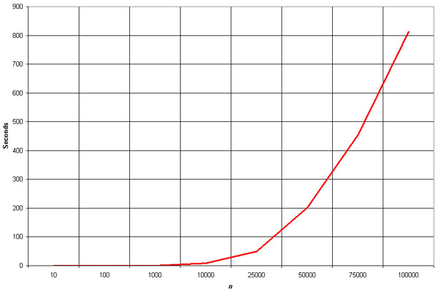
Time Complexity Model of the Worst Case
quadratic
Time in seconds
# elements

Slide 12
Closing Comments
…………………………………………………
The Bubble sort is not efficient, there are other sorting algorithms that are much faster…..

Slide 13
A Final Note
………………………………………………………………………
Thank you Prof. Jaimin Shroff for making this all possible

Slide 14
Reference
……………………………………………….
Design and Analysis of Algorithms, Dave and Dave, Pearson.
Fundamental of Algorithms by Gills Brassard, Paul Bratley, PHI.
Introduction to Design and Analysis of Algorithms, Anany Levitin, Pearson

Slide 15
Reference
………………………………………………
Design and Analysis of Algorithms, Dave and Dave, Pearson.
Fundamental of Algorithms by Gills Brassard, Paul Bratley, PHI.
Introduction to Design and Analysis of Algorithms, Anany Levitin, Pearson
Thank you

